Slide 1
Sound treatment
Sound Designer

Slide 2
Sound Treatment
Genre: Animation/Experimental
Sound: Silent film
Sound style: oriental
Each scene contains different feelings and moods, but they will deliver the same message. I will use sound effects, soundscape and music to add emotion and atmosphere for each scene in the film.

Slide 3


First Scene
The first scene is about two old women gossiping. The relationship between them is so close. In this scene the most important feelings we want the audience feel are affinity and friendship love. We will consider them on a small balcony. I will use low-pitched sounds, including sounds of Breeze, tree leaves, car of the vegetable seller, light laughter, kids playing , smoking and lighter.

Slide 4
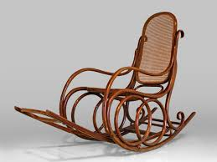

Second Scene
The second scene is about a mother and her daughter. The relationship between them is less strong than the first scene and the distance will be a little bit longer. The most important feeling in this scene is longing. In this scene also I will use low-pitched sounds, including sounds of rocker, berceuse, water drops clock ticking and Knitting.

Slide 5
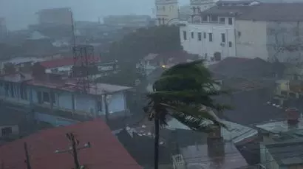
Third Scene
The third scene is about the conflict between a girl and her boyfriend. There is longer distance between them. The main feelings we want to show are love and anger. This scene will start with low-pitched sounds, including sounds of rain, calm heartbeat, breeze and Hot chocolate pour. Then when the camera reaches the young man I will use high-pitched sounds, including thunder, high heartbeat, torrential rain. At the end of the scene I will use low-pitched sounds again. During the camera transition between the two character I will use sound of rain and wind

Slide 6
Forth Scene
The fourth scene shows how the relationship is complicated between an old man and his son. I will use high-pitched sounds, including windmills and sea waves or wind hits a window and water drops.

Slide 7
Fifth Scene
At the end of the film, we will see an old man and woman fight. I will use high-pitched sounds, such as wind, footsteps on dry leaves, breaking glass / gun (bullet) and lighter. Also, I will use different tone of each sound.

Slide 8
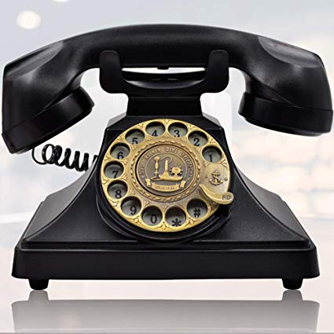
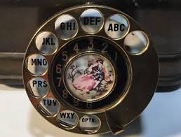
Transition
Between each two characters I will us sound of rotary dial telephone.

Slide 9
References
Soundscapes
https://www.youtube.com/watch?time_continue=27&v=BRLPh7r4rjQ
Rotary Phone Dialing
https://www.youtube.com/watch?v=7pIw9xyDQkY
Tension
https://www.youtube.com/watch?v=eX-fCDpS9fY
Berceuse
https://www.youtube.com/watch?v=PSxNvLxpKA4
Ambience
https://www.youtube.com/watch?v=XdrkkiYYZsM
Heavy rain
https://www.youtube.com/watch?v=j2bnj5hMkIw
Arabic Music
https://www.youtube.com/watch?v=rCOFfHqEVzo
Sound in filmmaking
http://thecinematheque.ca/education/wp-content/uploads/2012/02/LanguageofFilm07.pdf

